Slide 1
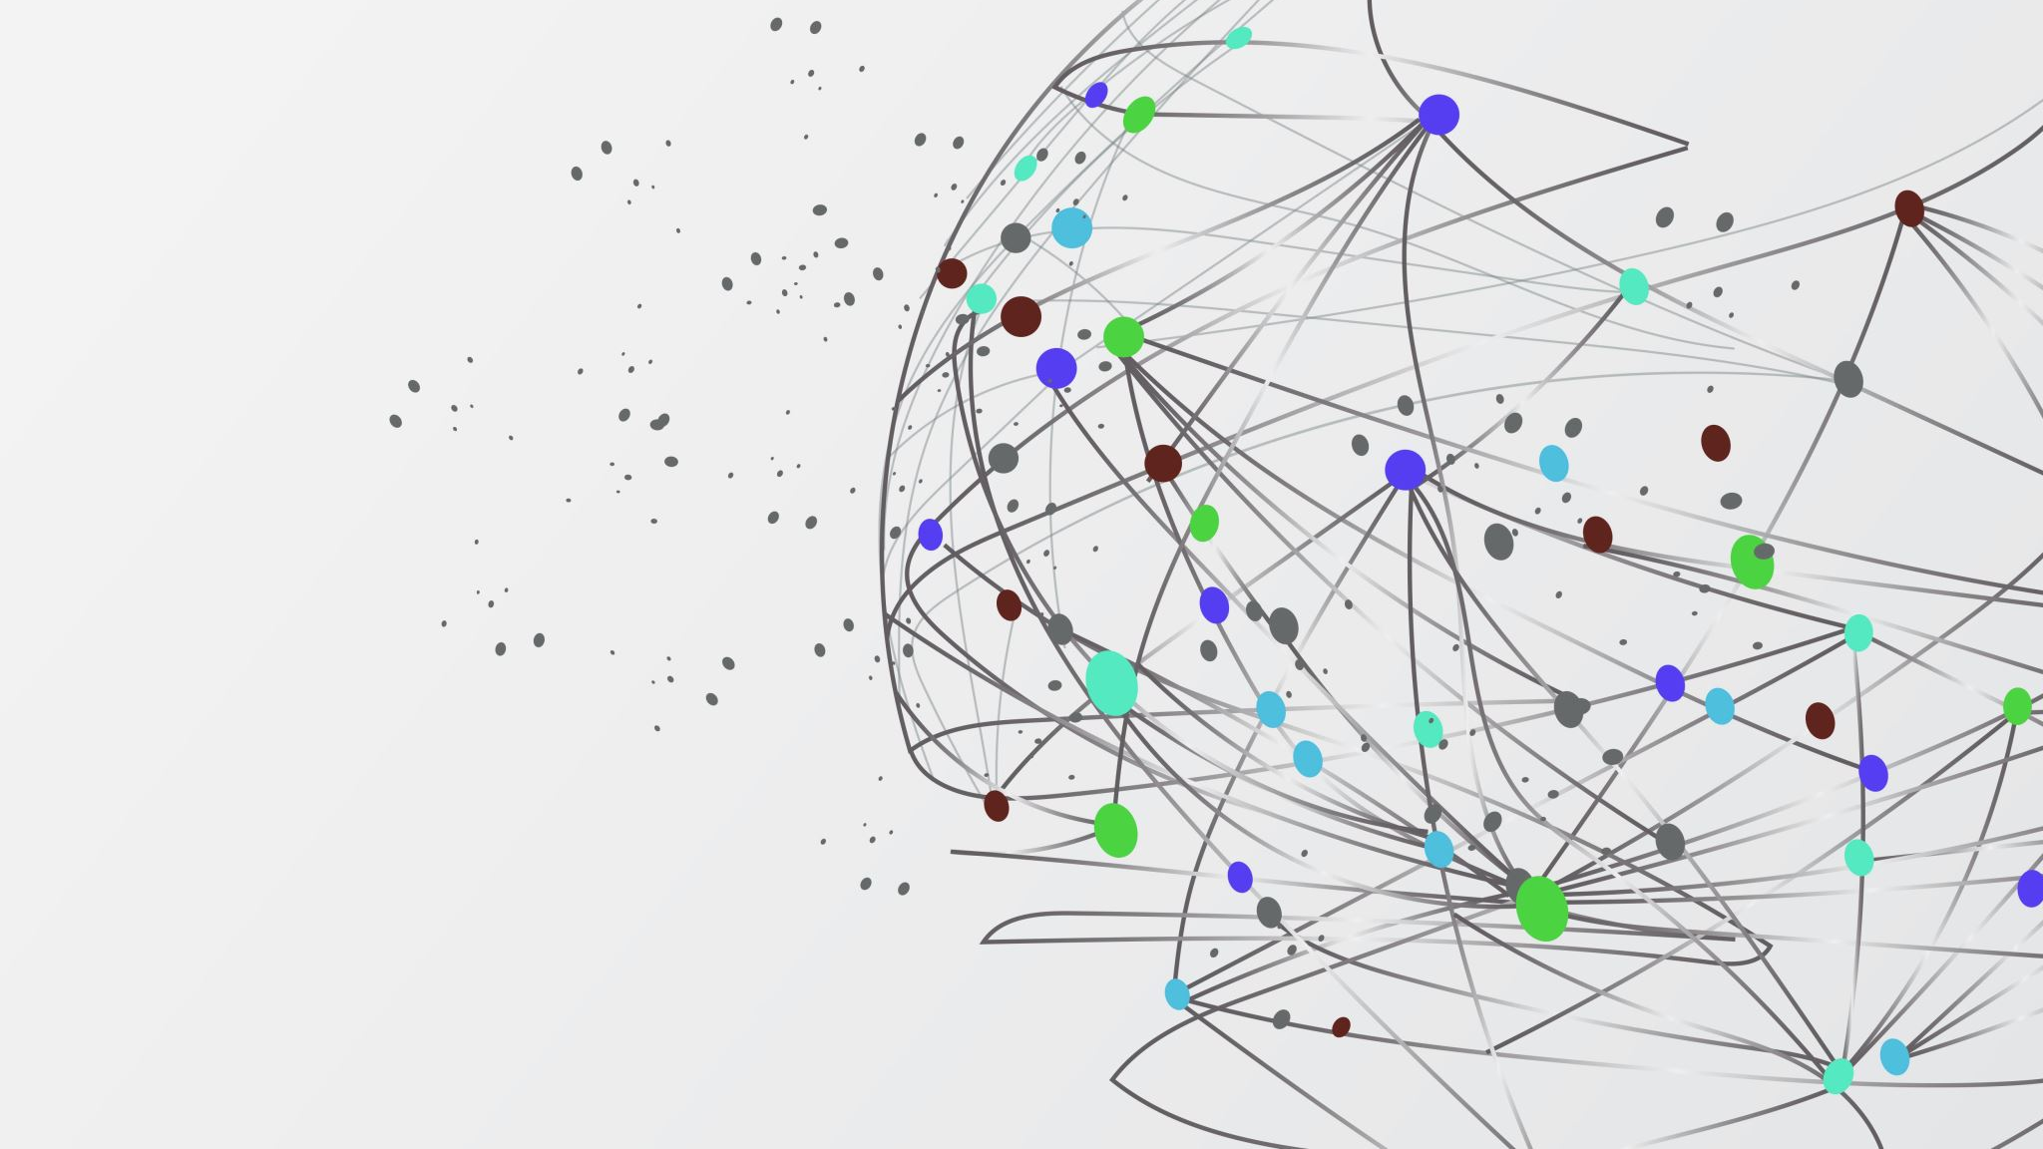

Lecture # 01 python programming with python Interview questions
Artificial Intelligence

Slide 2

Outcomes:
By the end of this Lecture, students should be able to:
Understand Python's interpretive nature, dynamic typing, and use of indentation
Write basic Python statements like print(), input(), type conversion and comments
Use variables to store, access and modify data in Python
Apply common data types like strings, integers, floats, Booleans, lists, tuples and dictionaries
Utilize arithmetic, comparison and logical operators to perform operations in Python
Create and call reusable functions with parameters and return values
Use control flow statements like if-else, for loops, while loops and switch case
Implement simple algorithms like finding min/max value, factorial computation using loops and recursion
Create and index into arrays, lists and dictionaries to store and organize data

Slide 3
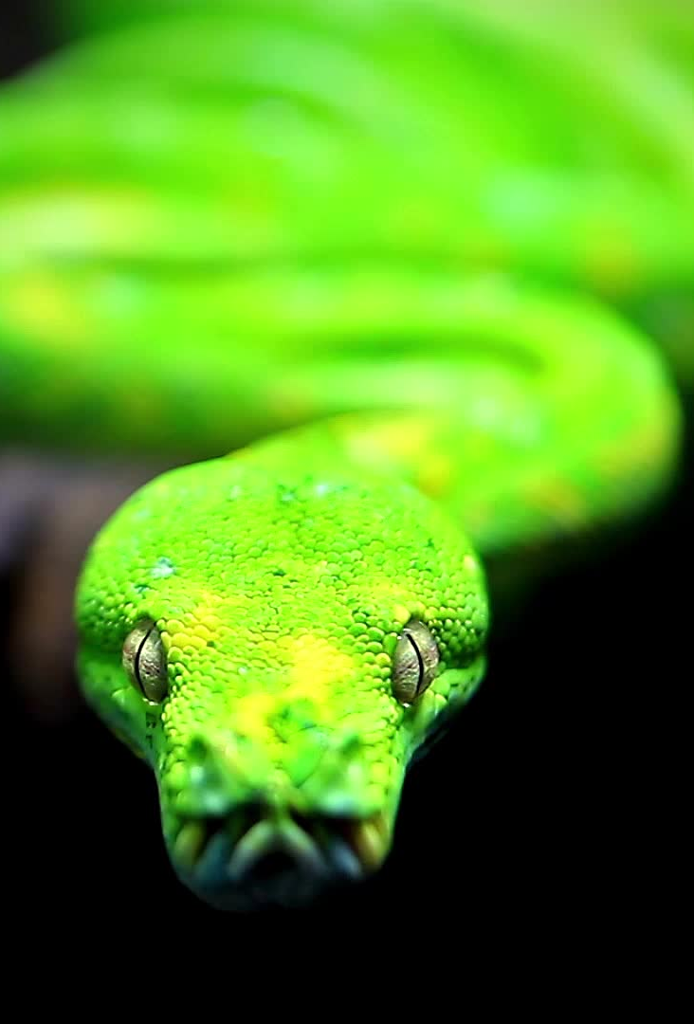
Why python in AI?
Python is widely used in AI for several reasons. Firstly, it's a high-level programming language, meaning it's easy to read and write, making it great for prototyping and experimenting with AI algorithms. Secondly, Python has a vast ecosystem of libraries specifically tailored for AI and machine learning tasks, such as TensorFlow, PyTorch, and scikit-learn, which make it easier to implement complex AI models. Additionally, Python's simplicity and versatility make it suitable for both beginners and experienced developers, fostering a vibrant community where knowledge sharing, and collaboration thrive. Lastly, Python's flexibility allows for integration with other technologies and systems, making it a popular choice for building AI applications that interact with various data sources and platforms. Overall, Python's combination of readability, powerful libraries, and community support make it a preferred language for AI development.

Slide 4
BASICS OF PYTHON (Printing)
print("Hello World")
print("My name is John")

Slide 5
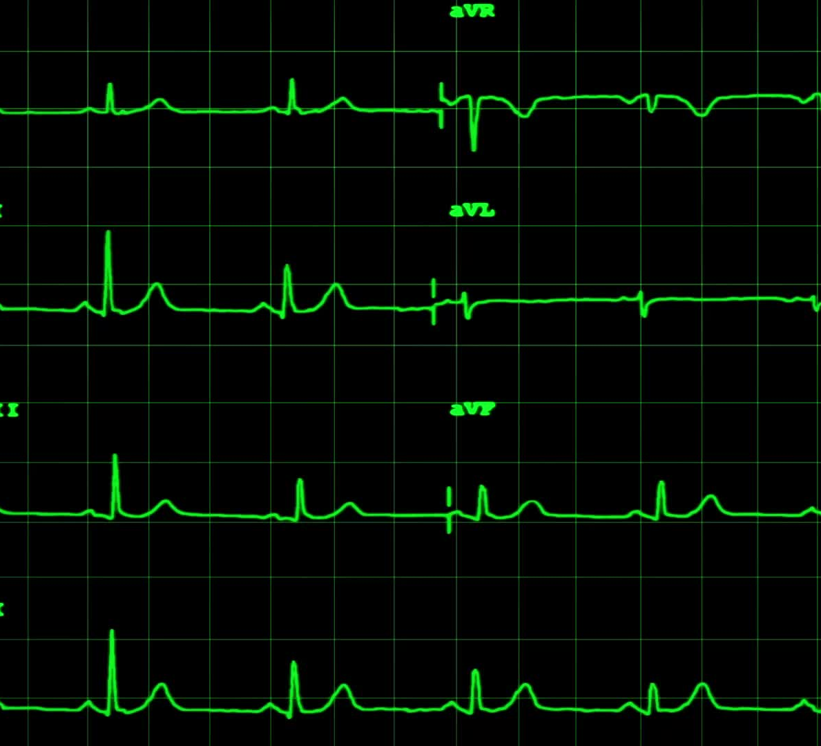
Comments in Python:
This is a comment
print("Hello") # This line prints Hello

Slide 6
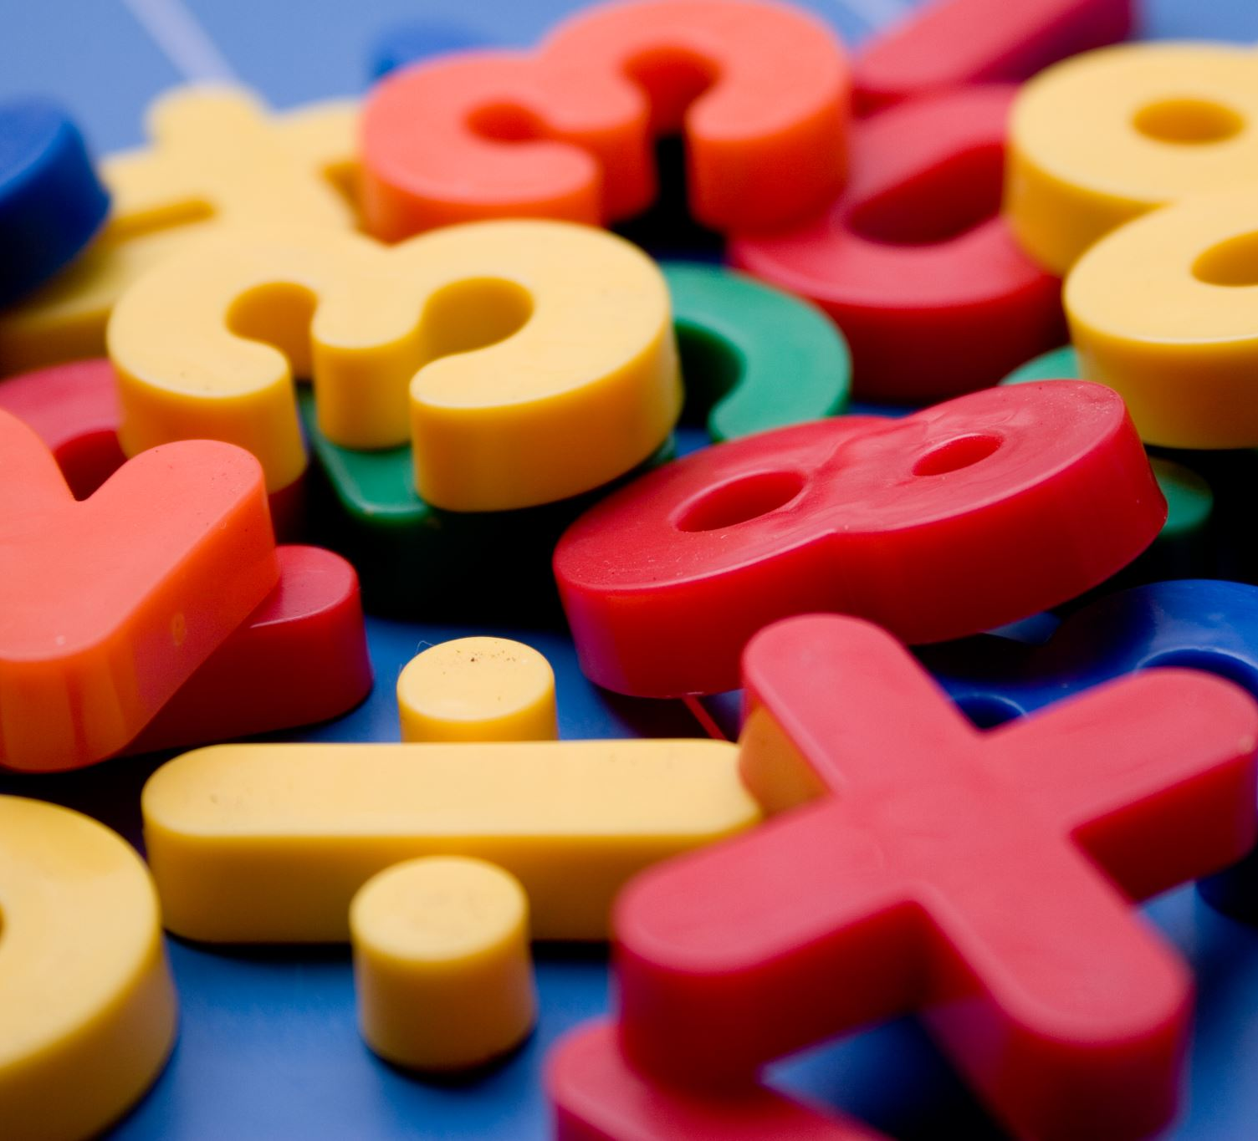
Arithmetic operators
x = 10 + 3 # Addition
y = 12 - 5 # Subtraction
z = 2 * 4 # Multiplication
a = 16 / 4 # Division
b = 15 % 4 # Modulus

Slide 7


Comparison operators
a = 10 b = 20
print(a == b) # Equal to
print(a != b) # Not equal to
print(a > b) # Greater than
print(a < b) # Less than
print(a >= b) # Greater than or equal to
print(a <= b) # Less than or equal to

Slide 8

Logical operators
a = True b = False
print(a and b) # Logical AND
print(a or b) # Logical OR
print(not a) # Logical NOT

Slide 9
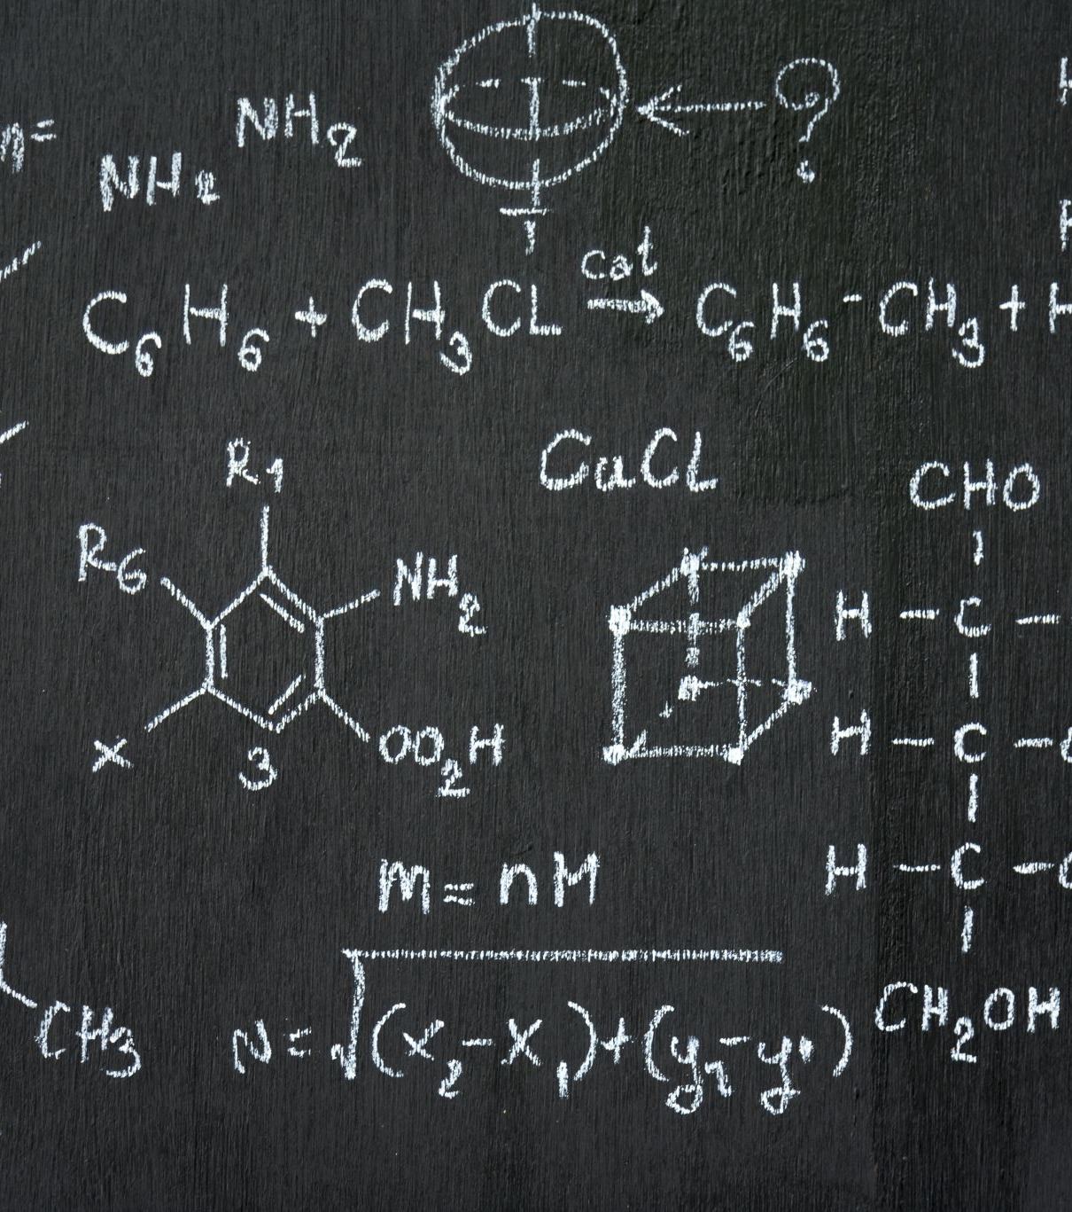
Assignment Operators
a = 10
a += 5 # a = a + 5
a -= 2 # a = a - 2
a *= 3 # a = a * 3
a /= 4 # a = a / 4

Slide 10
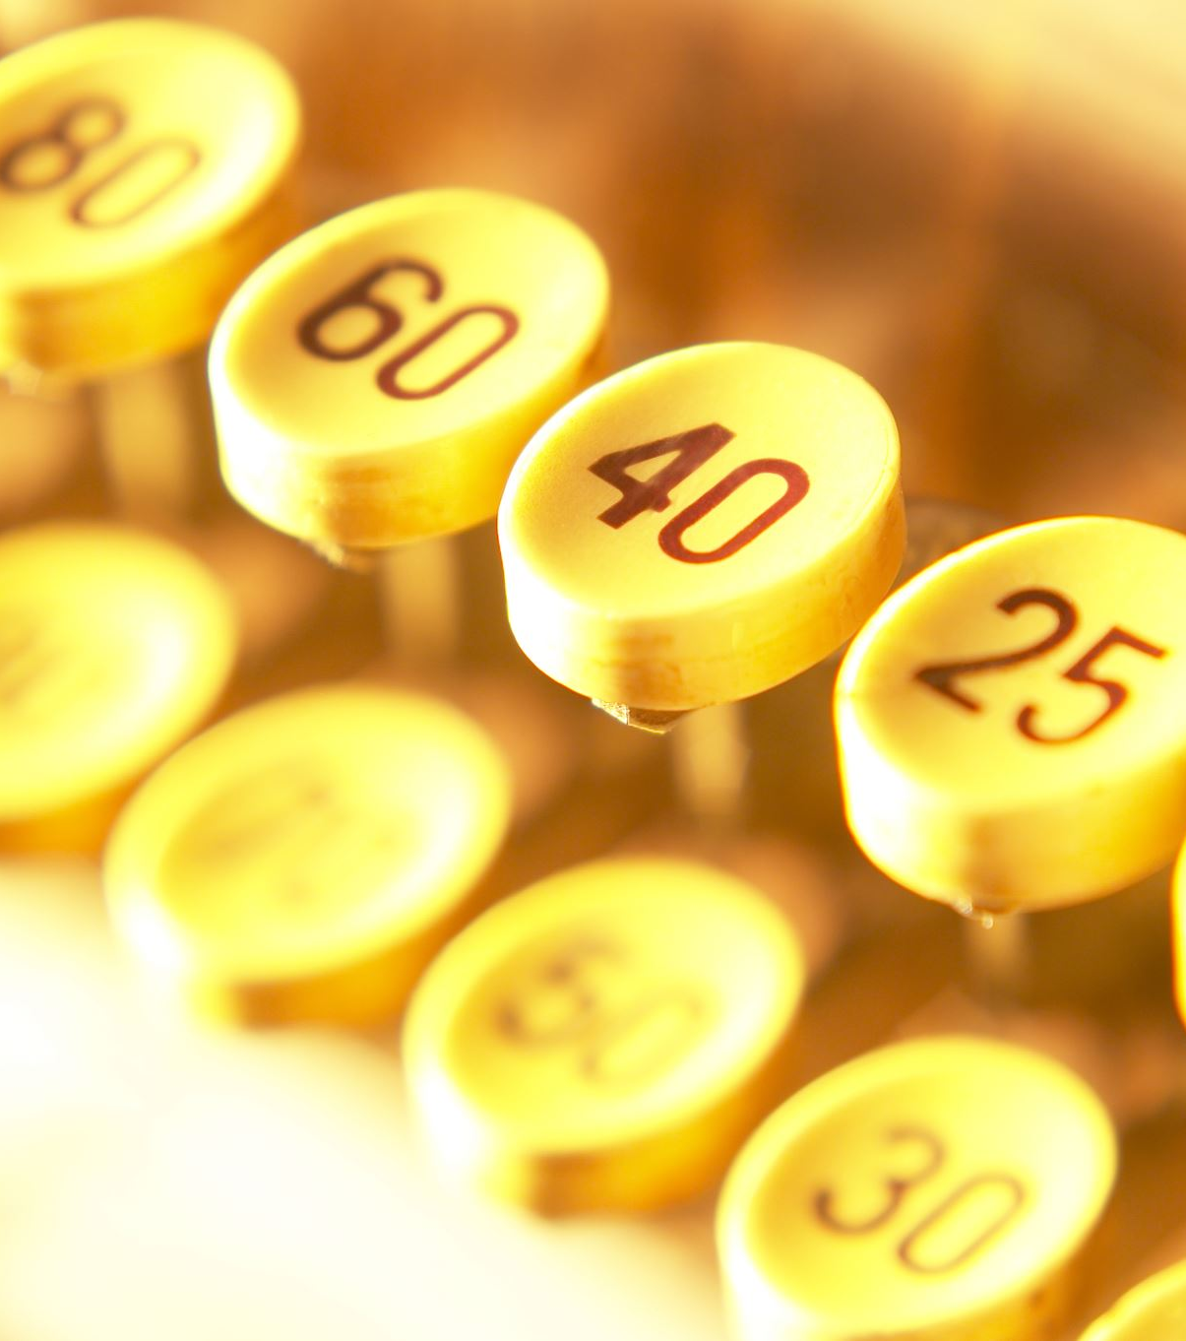
Arrays:
One dimensional array
arr = [1, 2, 3, 4, 5]
print(arr[0]) # Prints 1
print(arr[3]) # Prints 4
Multi dimensional array
matrix = [[1, 2, 3], [4, 5, 6], [7, 8, 9]]
print(matrix[0][2]) # Prints 3
print(matrix[2][1]) # Prints 8

Slide 11
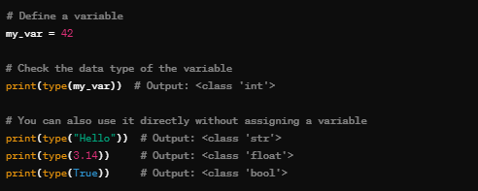
How to check datatype in python

Slide 12
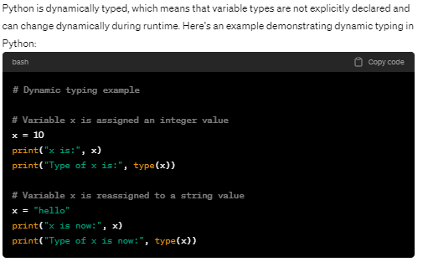
Python is which kind of language

Slide 13
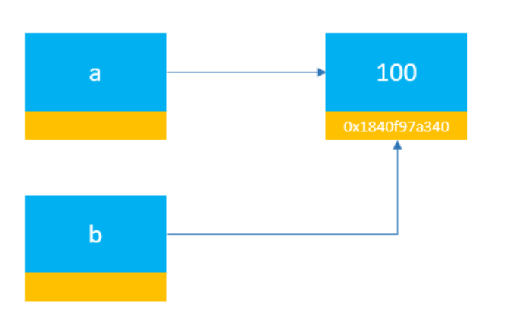
Is operator in python
# Example of using the 'is' operator
# Define two lists with the same elements
list1 = [1, 2, 3]
list2 = [1, 2, 3]
# Check if list1 and list2 are the same object
print("Are list1 and list2 the same object?", list1 is list2) # Output: False
# Assign list1 to list2
list2 = list1
# Check if list1 and list2 are the same object after assignment
print("Are list1 and list2 the same object after assignment?", list1 is list2) # Output: True

Slide 14
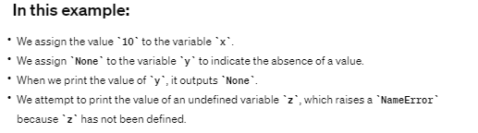
None vs undefined & try except block
# Example of using None and encountering an undefined variable
# Define a variable with a value
x = 10
# Assign None to a variable
y = None
# Print the value of y
print("Value of y:", y) # Output: None
# Trying to print the value of an undefined variable
try:
print("Value of z:", z)
except NameError as e:
print("Encountered an undefined variable:", e) # Output: Encountered an undefined variable: name 'z' is not defined

Slide 15
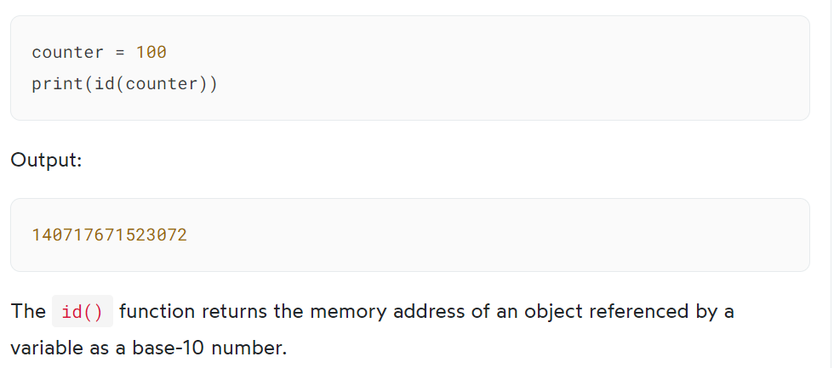
Python memory references

Slide 16
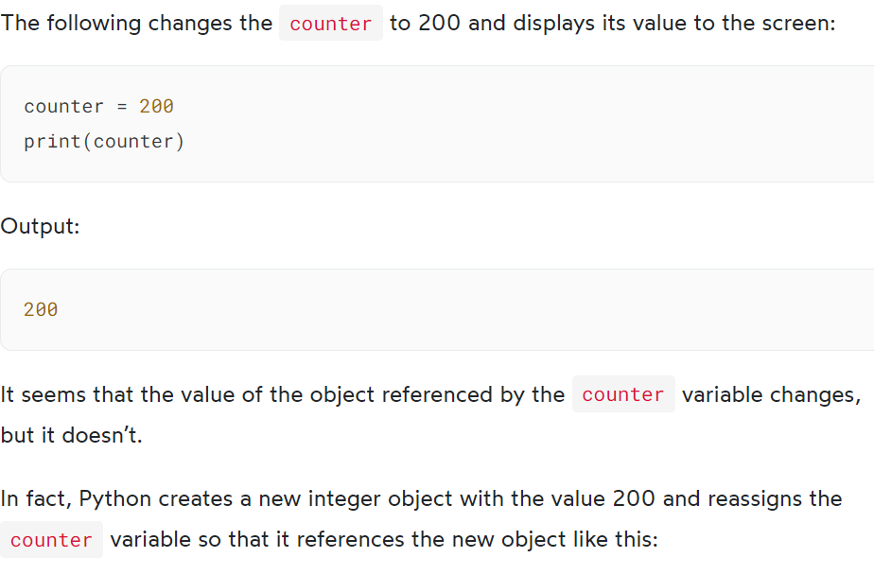
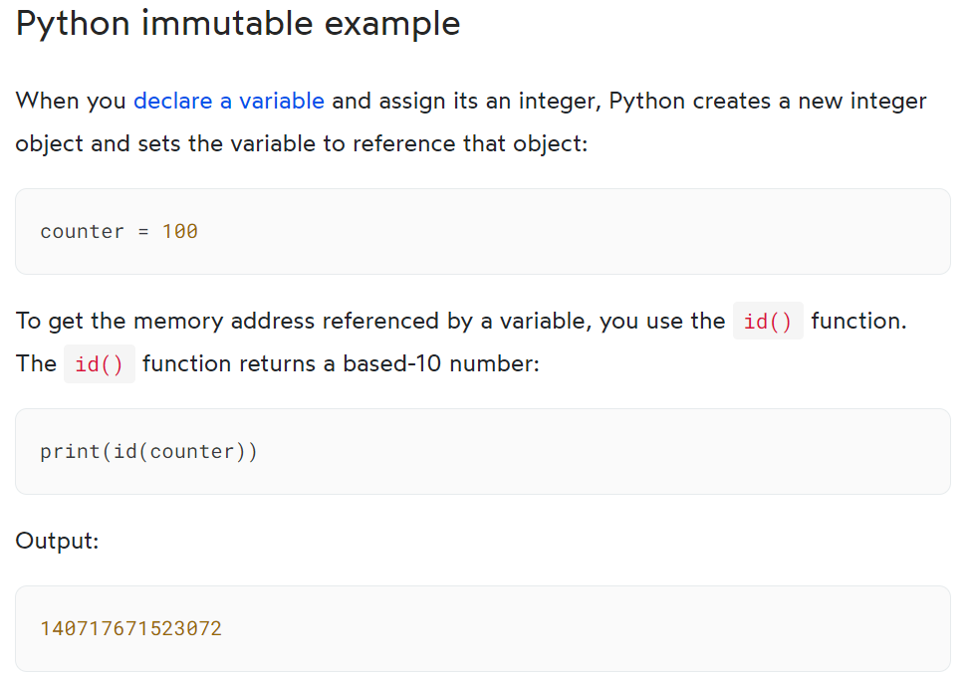
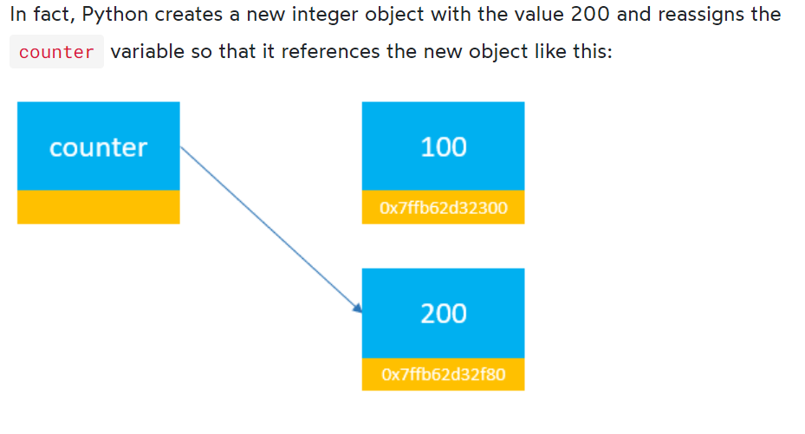
Python immutability

Slide 17
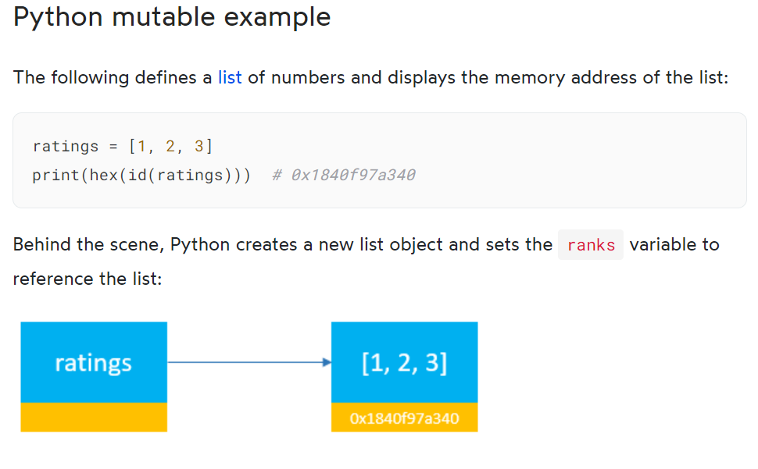
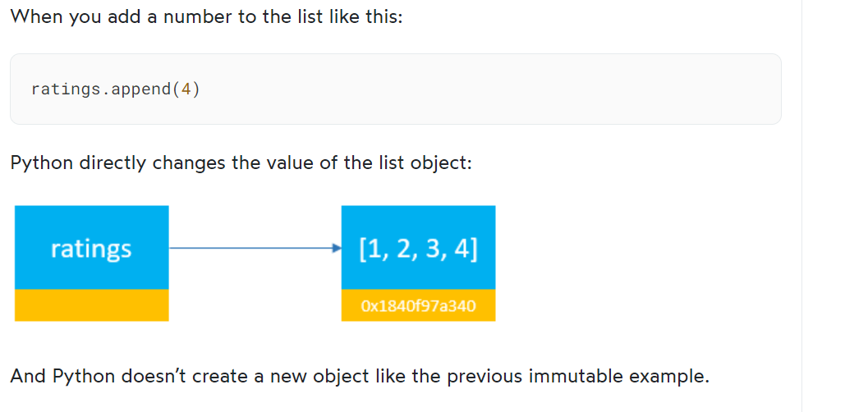
Python mutable example:

Slide 18
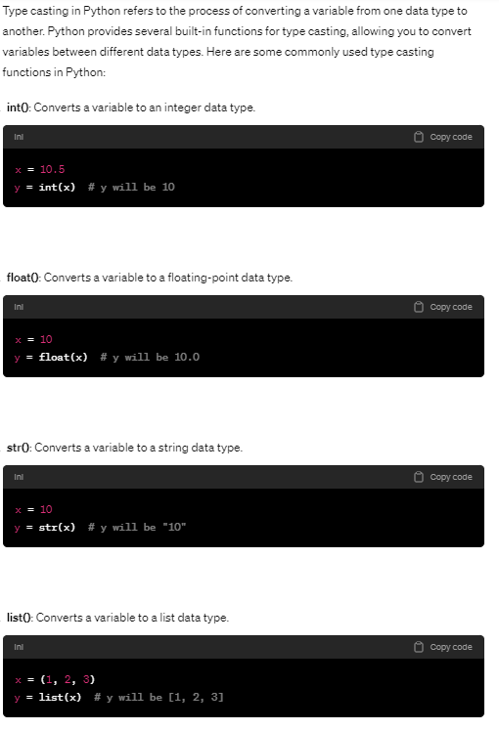
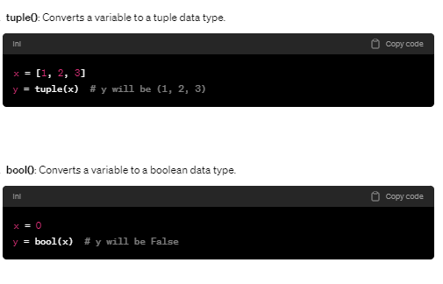
Type casting

Slide 19
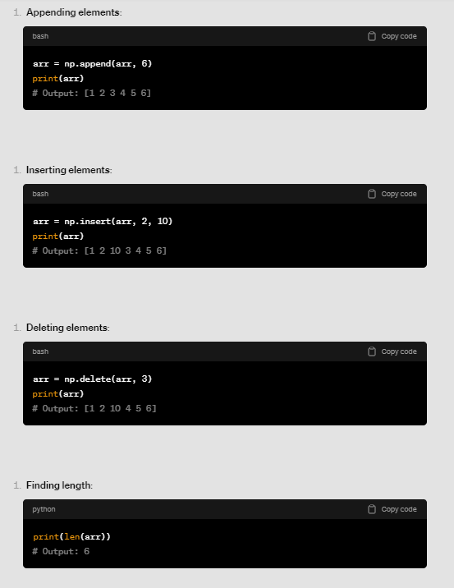
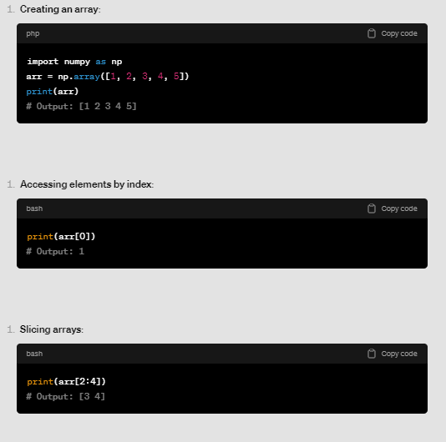
Arrays functions:

Slide 20
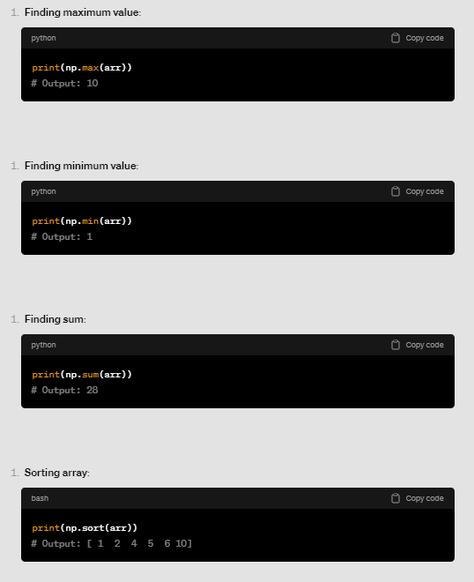
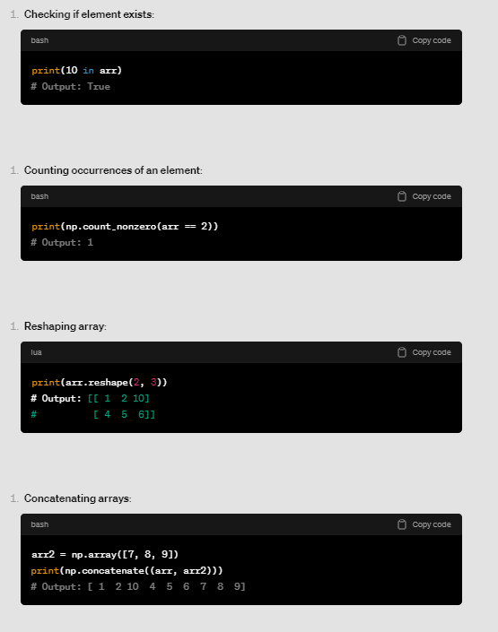

Slide 21
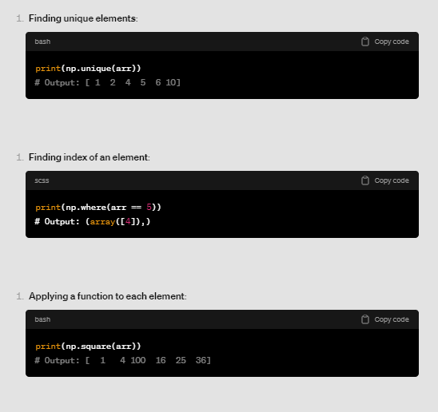
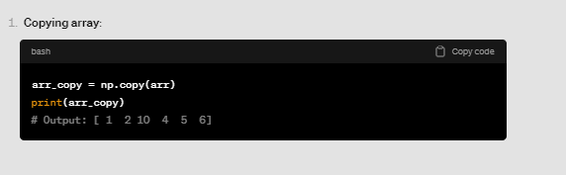

Slide 22
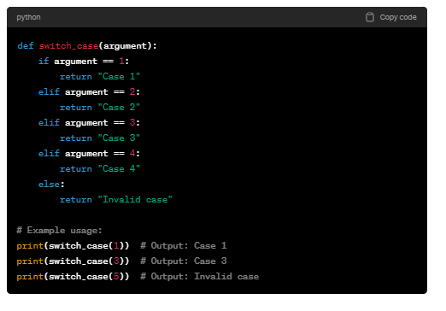

Switch statements:

Slide 23
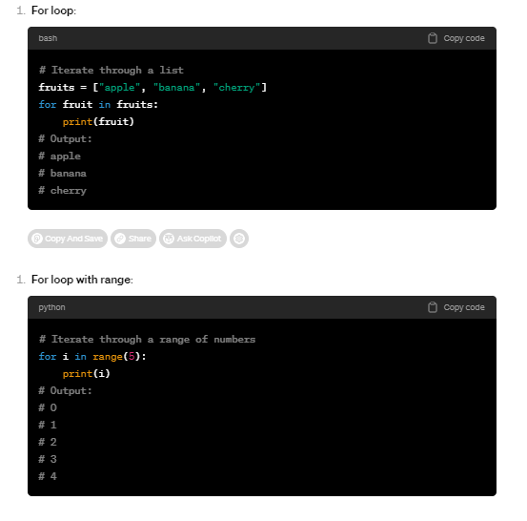
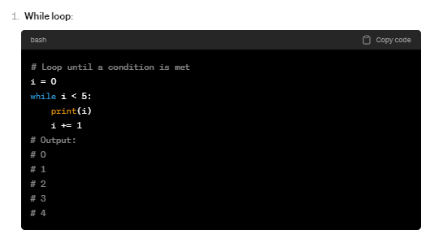
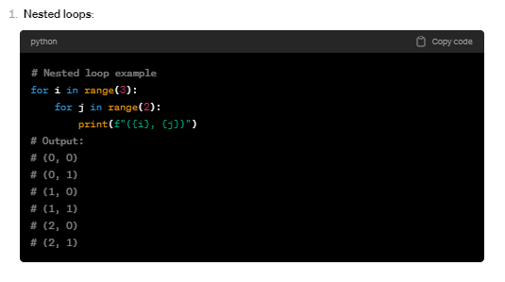
loops

Slide 24
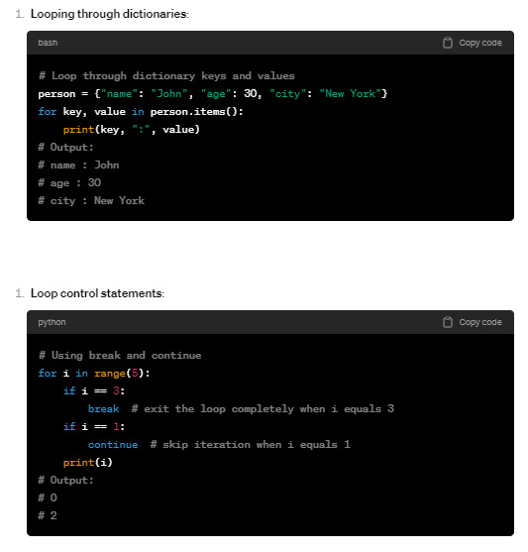

Slide 25
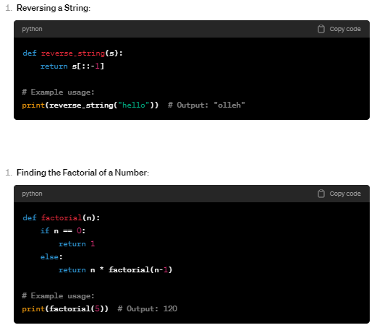
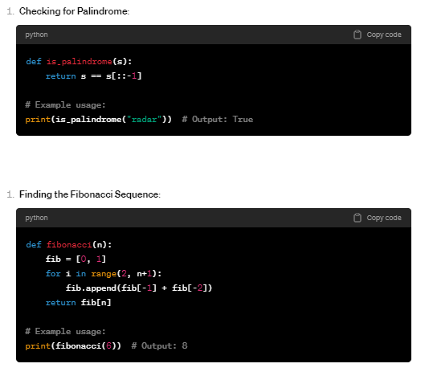
Python Interview questions

Slide 26
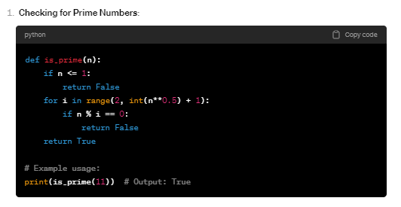
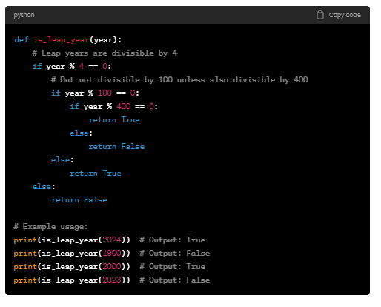

Slide 27

Reference link
https://www.pythontutorial.net

Slide 28
Tasks:
Calculator Program: Create a simple calculator program that can perform basic arithmetic operations like addition, subtraction, multiplication, and division.
Guess the Number Game: Write a program that generates a random number and asks the user to guess it. Provide hints such as "too high" or "too low" until the user guesses the correct number.
Palindrome Checker: Write a program that checks if a given string is a palindrome (reads the same forwards and backwards).
Word Counter: Create a program that counts the frequency of words in a given text file or input string.
Fizz Buzz: Write a program that prints the numbers from 1 to 100. But for multiples of three, print "Fizz" instead of the number, and for the multiples of five, print "Buzz". For numbers that are multiples of both three and five, print "Fizz Buzz".
Temperature Converter: Create a program that converts temperatures between Celsius and Fahrenheit.
Hangman Game: Implement the classic game of Hangman where the user has to guess a word by suggesting letters within a certain number of attempts.
File Manipulation: Write a program that reads data from a text file, performs some operation (e.g., sorting, filtering), and writes the result to another file.

